Slide 1
Agile Estimation
Lecturer: Ngo Huy Bien
Software Engineering Department
Faculty of Information Technology
VNUHCM - University of Science
Ho Chi Minh City, Vietnam
nhbien@fit.hcmus.edu.vn

Slide 2

Objectives
To estimate size in story points.
To estimate size using planning poker method.
To estimate size using Wideband Delphi method.

Slide 3

Contents
Story Points.
Planning Poker.
Wideband Delphi Method.

Slide 4

References
Mike Cohn (2005). Agile Estimating And Planning. Pearson Education.
Jonathan Rasmusson (2010). The Agile Samurai: How Agile Masters Deliver Great Software. Pragmatic Bookshelf.
Karl E. Wiegers (2000). Stop Promising Miracles.

Slide 5
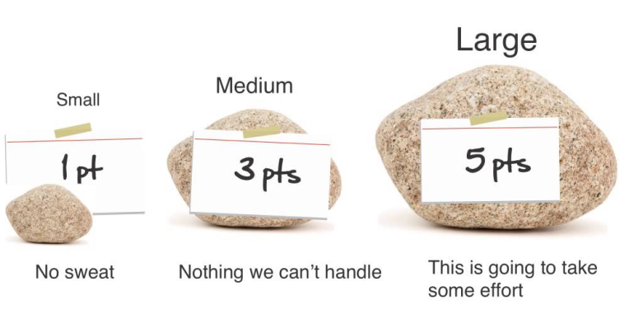
Estimating Size with Story Points [1]
Story points are a unit of measure for expressing the overall size of a user story, feature, or other piece of work.
The raw value we assign is unimportant.
What matters are the relative values.
A story that is assigned a two should be twice as much as a story that is assigned a one.

Slide 6
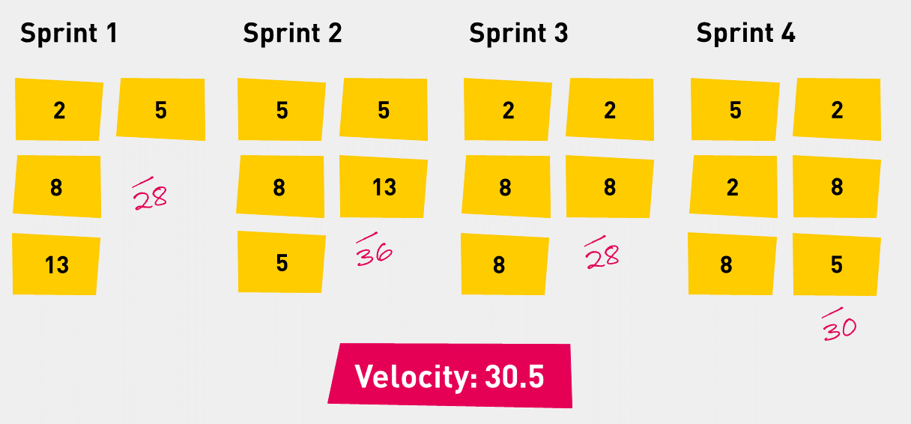
Velocity
Velocity is a measure of a team’s rate of progress.
It is calculated by summing the number of story points assigned to each user story that the team completed during the iteration.
If the team completed three stories each estimated at five story points then their velocity would be fifteen.

Slide 7
Ideal Days
On a software project, we may choose to estimate user stories or other work in ideal days.
When estimating in ideal days you assume that:
the story being estimated is the only thing you’ll work on
everything you need will be on hand when you start
there will be no interruptions
When estimating in ideal days it is best to associate a single estimate with each user story.
Rather than estimating that a user story will take four programmer days, two tester days, and three product owner days, it is better to sum those and say the story as a whole will take nine ideal days. Why?

Slide 8
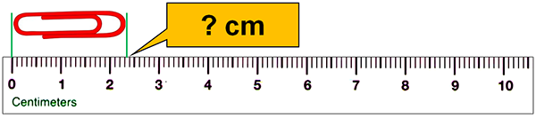
The Estimation Scale
1, 2, 3, 5, and 8: The gaps in the sequence become appropriately larger as the numbers increase.
A number in the Fibonacci sequence is generated by taking the sum of the previous two numbers.
1, 2, 4, and 8: each number is twice the number that precedes it.
These non-linear sequences work well because they reflect the greater uncertainty associated with estimates for larger units of work.
Free lunches: If the team does elect to include 0 in its estimation scale, everyone involved in the project (especially the product owner) needs to understand that 13 × 0 ≠ 0.

Slide 9
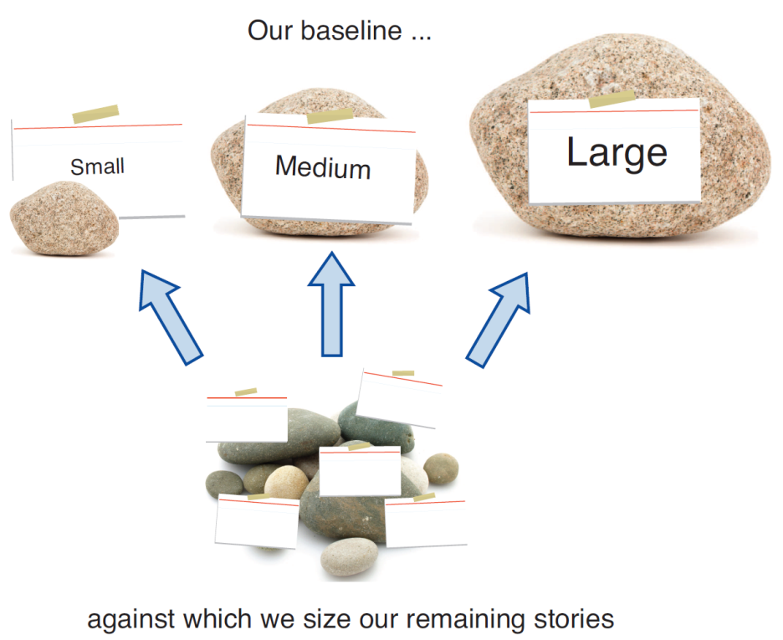
Deriving an Estimate: Analogy [1, 2]
You want to estimate each new story against an assortment of those that have already been estimated.

Slide 10
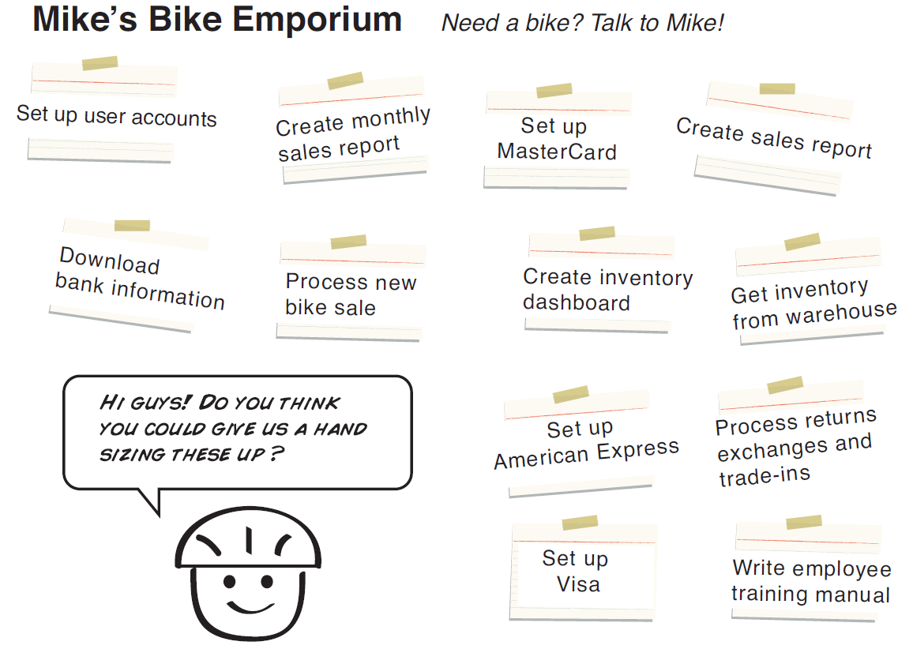
Deriving an Estimate: Disaggregation
Splitting a story or feature into smaller, easier-to-estimate pieces.
If most of the user stories to be included in a project are in the range of 2-5 days to develop, it will be very difficult to estimate a single story that may be 100 days.

Slide 11

Deriving an Estimate: Expert Opinion
This approach is less useful on agile projects than on traditional projects. Why?
On an agile project, estimates are assigned to user stories or other user-valued functionality.
Developing this functionality is likely to require a variety of skills normally performed by more than one person.
This makes it difficult to find suitable experts who can assess the effort across all disciplines.

Slide 12

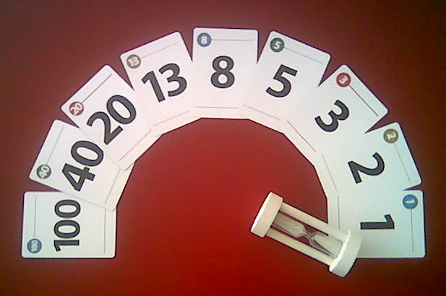
Planning Poker [1]
Planning poker combines expert opinion, analogy, and disaggregation into an enjoyable approach to estimating that results in quick but reliable estimates.
The right amount of discussion: Buy a two-minute sand timer and place it in the middle of the table where planning poker is being played.

Slide 13
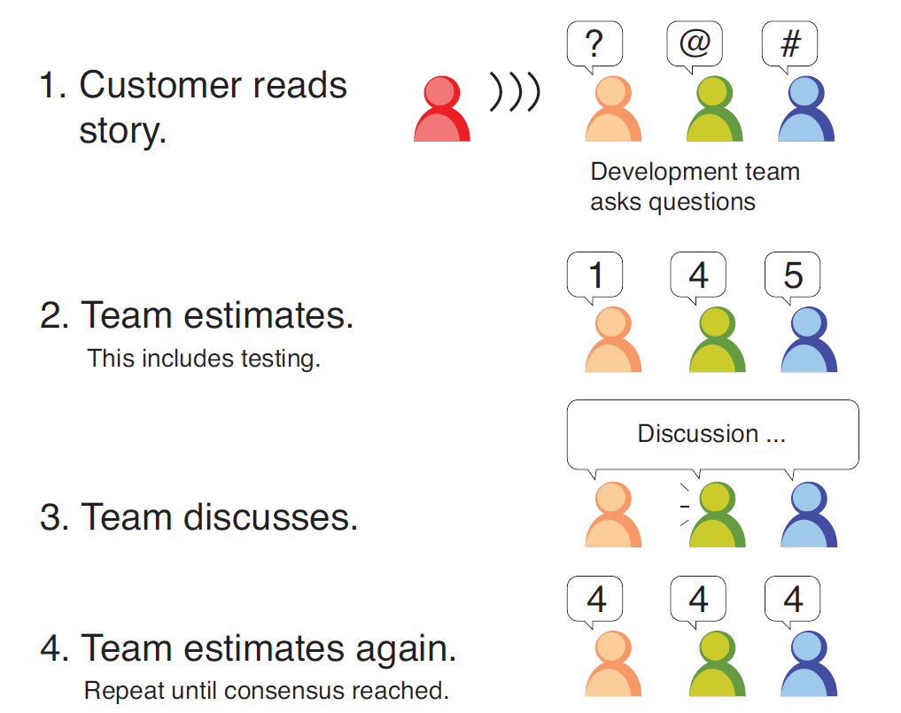
How Does Planning Poker Work? [2]
Three juniors don’t outvote one experienced senior.
Size your stories small (one, three, and five points with the occasional epic).

Slide 14


Slide 15



Wideband Delphi Method [3]
A problem specification
A moderator, who plans and coordinates the activity, the project manager and two to four other estimators.
The team reviews the estimation objectives and discusses the problem and any estimation issues.
The participants agree on the estimation units.
All team members are sufficiently knowledgeable to contribute to the estimation activity.

Slide 16
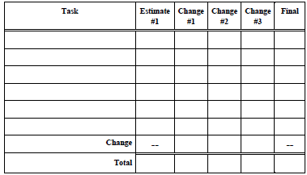
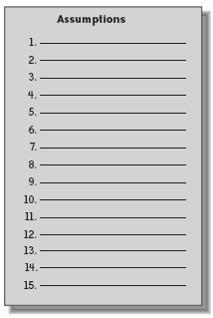
Individual Preparation
The estimation process begins with each participant independently developing an initial list of the tasks that will have to be completed to reach the stated project goal.
Each participant then estimates the effort each task will consume.

Slide 17
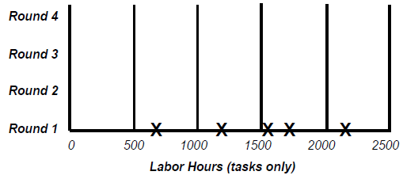
Estimation Meeting – Round 1
The moderator begins the estimation meeting by collecting the participants’ individual estimates and creating a chart.
The moderator does not identify who created each estimate.

Slide 18
Estimation Meeting – Discussion
Each estimator reads out his or her initial task list, identifying any assumptions made and raising any questions or issues, without revealing which estimate was theirs.
Each participant will have listed different tasks that need to be performed. Combining these individual task lists leads to a more complete list.
During this initial discussion, the team members also talk about their assumptions, estimation issues and questions they have about the problem.

Slide 19
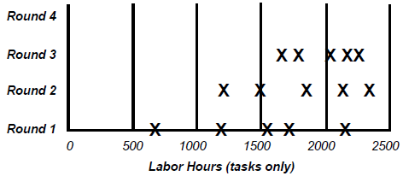
Estimation Meeting – Round 2
All participants modify their estimates concurrently (and silently) in the meeting room.
All estimators can add new tasks to their forms and note any changes they wish to make to their initial task estimates.
The moderator collects the revised overall estimates and plots them on the same chart.

Slide 20
Assembling Tasks and Review
Either the moderator or the project manager assembles the project tasks and their individual estimates into a single master task list, merges the individual lists of assumptions, quality- and process-related activities, overhead tasks and wait times.
The merging process involves removing duplicate tasks and reaching some reasonable resolution of different estimates for individual tasks.
The estimation team reviews the summarized results and reaches agreement on the final outcome.

Slide 21
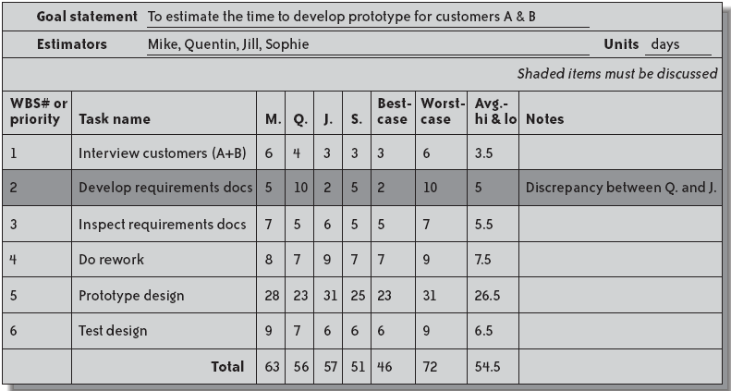
Master Task List

Slide 22

Thank You & See You Again

